Slide 1
White River Family Practice: Improving Quality through EHR in Small Ambulatory Practices

Slide 2
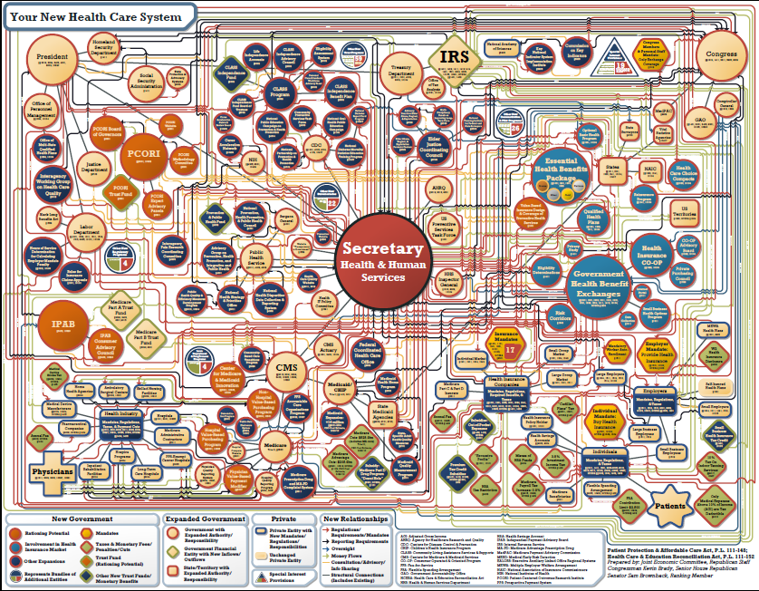

Slide 3
Goals of Webinar
Introduction to White River Family Practice
The Problem
Clinical Microsystems
EHR-enabled and quality improvement culture
ROI
Replication of our work

Slide 4
White River Family Practice
6 FP’s, 3 ARNP’s (total: 5.5 FTEs)
~10,000 active patients
eClinicalWorks EHR – 4/10
Hosted Server
Analytics: Excel, SPC Control Charts
Developing Social Media

Slide 5
White River Family Practice Davies Team
Mark Nunlist, MD
Sean Uiterwyk, MD
Joanne Arey

Slide 6
White River Family Practice
Meaningful Use Attestation
Year 1, 9/11
Year 2, 1/13
Year 3, 1/14
Patient Centered Medical Home, 9/12, NCQA
Blueprint for Health, State of Vermont
Geisel School of Medicine at Dartmouth
HIMSS Davies Award, 2013

Slide 7
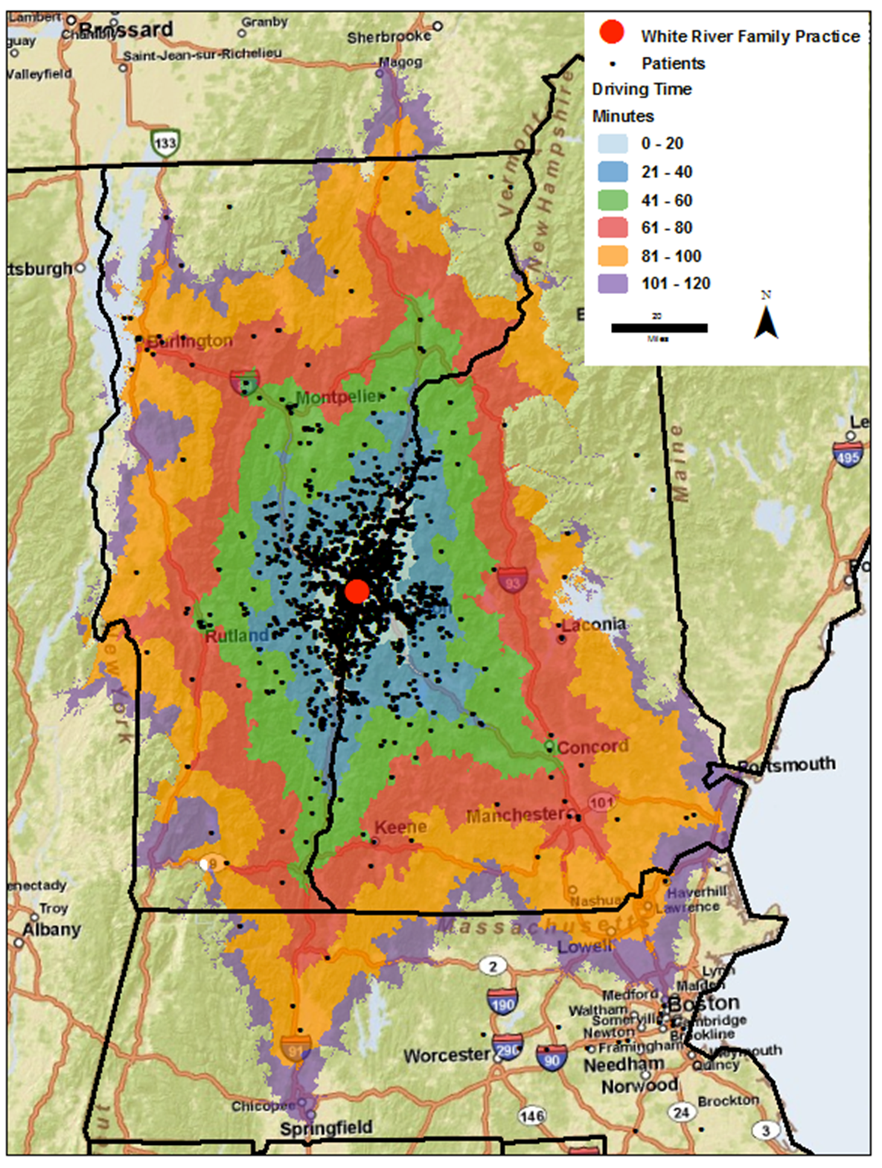

Slide 8
Tetanus Shots

Slide 9
The Problem
Prior to EHR
Unable to identify proportion of patients current with respect to guidelines
Unable to identify population for whom care is indicated
Patients were not receiving guideline recommended care
High number of guidelines
Difficulty prioritizing care during limited appointment time
Lack of current dashboard regarding patient status regarding recommended care

Slide 10
Our Strategic Objective: Use EHR to provide quality care
Provide & document excellent care
Improve clinical value of care provided
Individual patients
Patient population management
Develop as a clinical microsystem
Office team, not just the practitioner alone - responsible to provide care
Use data over time to improve quality
Notes:
clinical microsystem - defined as “a small group of people who work together on a regular basis to provide care to discrete subpopulations of patients” and having “clinical and business aims, linked processes, a shared information environment, and [producing] performance outcomes.”

Slide 11
Implementation Process:
Formed a committed EHR Group – “Our Tuesday Morning Breakfast Club”
Train entire office on correct EHR use
Define and use structured data fields
Understand and use EHR consistently
Collect data

Slide 12
Implementation: What Doesn’t Work
Trying too much at once
Expecting results from the EHR alone
Nebulous organizational goals
Inadequate feedback
Variation
Documentation of care
Multiple processes for same care

Slide 13
Implementation: What Does Work
Select targets to improve
Entire office contributes to improvement ideas
Map key processes
Measure progress over short intervals
Provide frequent feedback
Understand and use graphical reporting tools

Slide 14
ROI

Slide 15
Key Investments
Office Preparation
System Training
Network configuration and support
Voice recognition
Engagement with vendor

Slide 16
Key Revenue
VITL Grant
CMS Meaningful Use
Vermont Blueprint
Transcription & Billing Savings

Slide 17
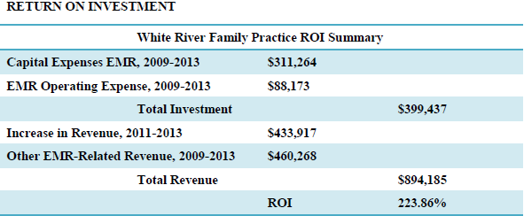
EHR Investment and Revenue Summary

Slide 18
Utilizing Data From EHR
Data management beyond the EHR
Statistical Process Control Charts
Easily used

Slide 19
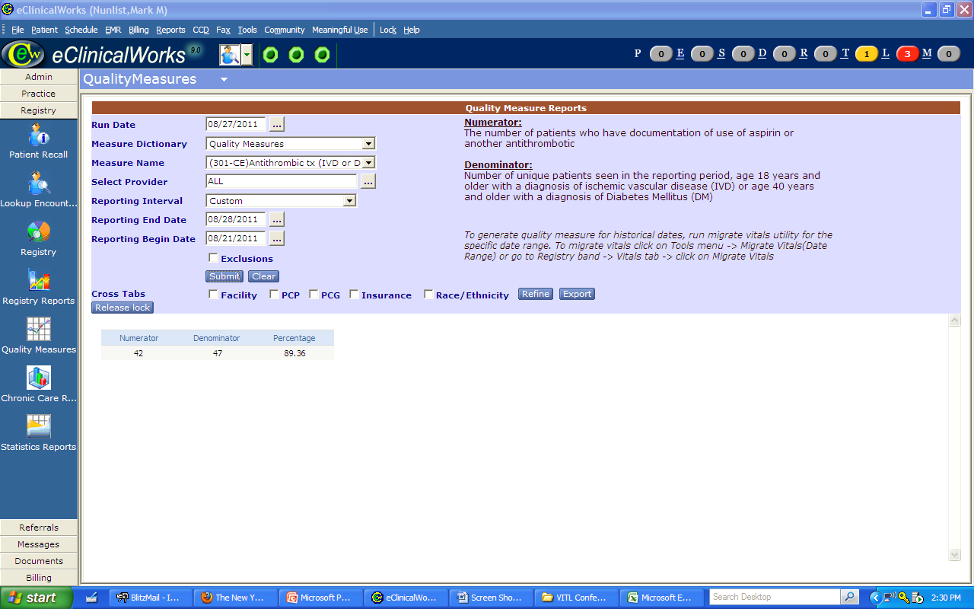
Steps for recoding and reporting
Measure Name
Definitions
Reporting period
The data

Slide 20
Utilizing Data From EHR
Measure |  | Smoking Cessation Intervention |  |  |  | Antithrombic tx (IVD or DM) |  |  |  | Alcohol Use Screening |  |  |  | Pneumococcal Vaccine
Date (ending) |  | N | D | Percent |  | N | D | Percent |  | N | D | Percent |  | N | D | Percent
(baseline) |  | 103 | 488 | 21.1% |  | 313 | 426 | 73.5% |  | 155 | 5288 | 2.9% |  | 737 | 2102 | 35.1%
4/1/11 |  | 71 | 198 | 35.9% |  | 150 | 183 | 82.0% |  | 62 | 1338 | 4.6% |  | 291 | 745 | 39.1%
4/10/11 |  | 36 | 69 | 52.2% |  | 46 | 58 | 79.3% |  | 10 | 455 | 2.2% |  | 102 | 267 | 38.2%
4/17/11 |  | 27 | 54 | 50.0% |  | 41 | 48 | 85.4% |  | 13 | 385 | 3.4% |  | 99 | 238 | 41.6%
< >
4/7/13 |  | 28 | 38 | 73.7% |  | 53 | 57 | 93.0% |  | 173 | 345 | 50.1% |  | 140 | 244 | 57.4%
4/14/13 |  | 35 | 49 | 71.4% |  | 53 | 60 | 88.3% |  | 201 | 387 | 51.9% |  | 171 | 291 | 58.8%
4/21/13 |  | 36 | 53 | 67.9% |  | 49 | 54 | 90.7% |  | 177 | 344 | 51.5% |  | 159 | 267 | 59.6%
4/28/13 |  | 42 | 55 | 76.4% |  | 48 | 51 | 94.1% |  | 176 | 367 | 48.0% |  | 158 | 270 | 58.5%
5/5/13 |  | 24 | 34 | 70.6% |  | 54 | 56 | 96.4% |  | 179 | 340 | 52.6% |  | 146 | 259 | 56.4%
5/12/13 |  | 22 | 37 | 59.5% |  | 45 | 51 | 88.2% |  | 160 | 353 | 45.3% |  | 132 | 256 | 51.6%
5/19/13 |  | 32 | 50 | 64.0% |  | 54 | 60 | 90.0% |  | 167 | 370 | 45.1% |  | 164 | 276 | 59.4%
5/26/13 |  | 23 | 43 | 53.5% |  | 66 | 70 | 94.3% |  | 195 | 379 | 51.5% |  | 173 | 278 | 62.2%
6/2/13 |  | 27 | 37 | 73.0% |  | 57 | 64 | 89.1% |  | 141 | 307 | 45.9% |  | 144 | 236 | 61.0%
6/9/13 |  | 30 | 47 | 63.8% |  | 52 | 57 | 91.2% |  | 177 | 363 | 48.8% |  | 144 | 259 | 55.6%
6/16/13 |  | 34 | 50 | 68.0% |  | 58 | 61 | 95.1% |  | 159 | 364 | 43.7% |  | 142 | 263 | 54.0%
6/23/13 |  | 26 | 40 | 65.0% |  | 42 | 47 | 89.4% |  | 166 | 340 | 48.8% |  | 119 | 229 | 52.0%

Slide 21
Utilizing SPC Charts
Measure |  | Antithrombic tx (IVD or DM)
Date (ending) |  | N | D | Percent
(baseline) |  | 313 | 426 | 73.5%
4/1/11 |  | 150 | 183 | 82.0%
4/10/11 |  | 46 | 58 | 79.3%
4/17/11 |  | 41 | 48 | 85.4%
< >
4/7/13 |  | 53 | 57 | 93.0%
4/14/13 |  | 53 | 60 | 88.3%
4/21/13 |  | 49 | 54 | 90.7%
4/28/13 |  | 48 | 51 | 94.1%
5/5/13 |  | 54 | 56 | 96.4%
5/12/13 |  | 45 | 51 | 88.2%
5/19/13 |  | 54 | 60 | 90.0%
5/26/13 |  | 66 | 70 | 94.3%
6/2/13 |  | 57 | 64 | 89.1%
6/9/13 |  | 52 | 57 | 91.2%
6/16/13 |  | 58 | 61 | 95.1%
6/23/13 |  | 42 | 47 | 89.4%
SPCXL

Slide 22
Utilizing Data From EHR

Slide 23
SPC Charts
Sigma Zone Software
Data vs Information
Rooted in manufacturing
Signal vs. Noise

Slide 24
Dashboards
When you change the way you look at things, the things you look at change

Slide 25
Clinical Dashboards
Actionable information for clinician at the time of the encounter
Pre-Visit Planning
CDSS
Practice Based Alerts
Information for the patient
WRFP Portal
Information for providers/practice

Slide 26
Clinician's View: Progress Note Dashboard

Slide 28
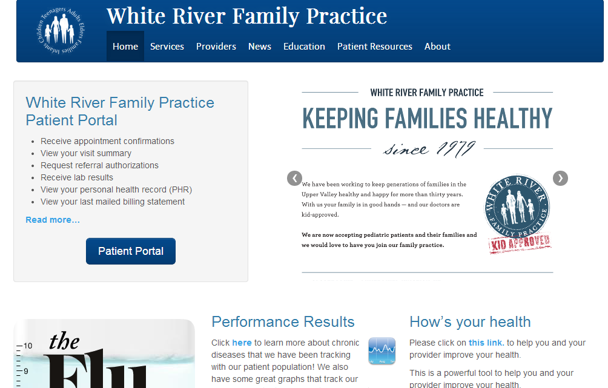
Patient’s View: Patient Portal

Slide 29
Patient’s View: Patient Portal

Slide 30
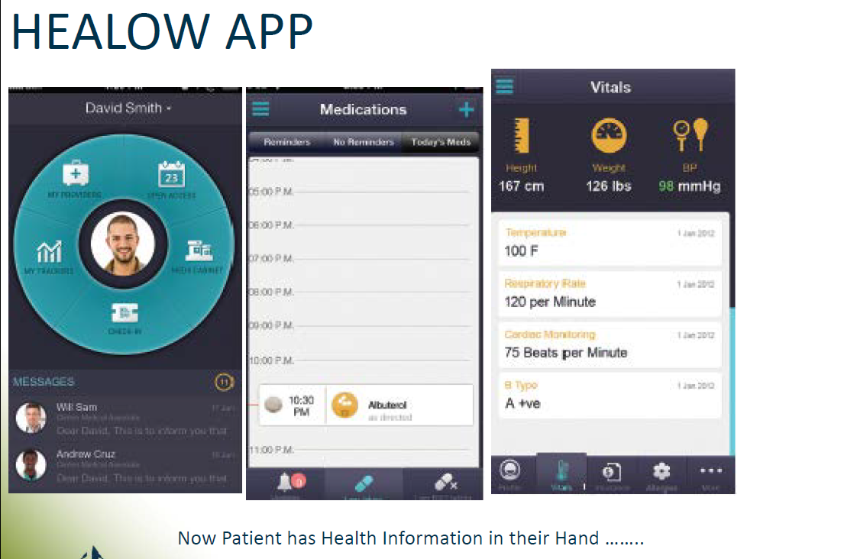

Slide 31
Utilizing EHR Reports
Data Display – to WRFP staff and providers
Feedback to the public
Maintain gains and set new goals

Slide 32
Data Display to WRFP Team

Slide 33
Feedback to Public
White River Family Practice Website Quality Graphs
How’s Your Health
Patient Self-Confidence

Slide 34
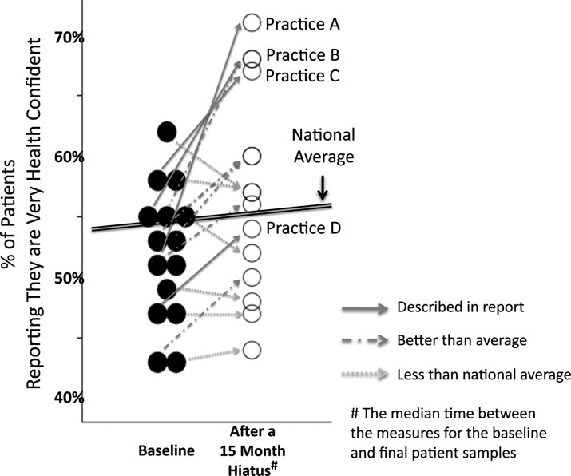
Improvement in Patient-Reported Health Confidence: 15 Office Practices and a National
Comparison.
(WRFP is “Practice A.”)
Ref: JACM, Vol. 36, #3, pp. 235-240
Notes:
Worth adding for “Wow” with discussion?

Slide 35
Population Health
Preventative Health
Chronic Disease Management
Asthma
Diabetes
Tobacco Use

Slide 36
Asthma Management
Asthma Care Processes
Asthma Action Plans
Asthma Control Test
Influenza Vaccination
Updated Problem List
Asthma Severity
Spirometry

Slide 37
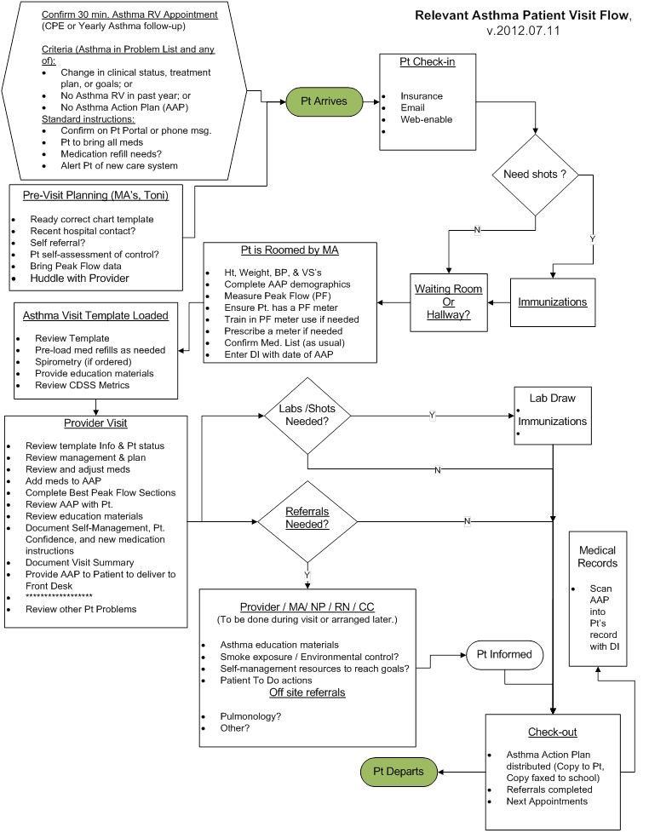

Slide 39
Improving asthma management: asthma control test

Slide 40
Improving Management and Outcomes in Diabetes

Slide 41
Diabetes : improving management

Slide 42
Diabetes “Package” Care

Slide 43
Improving outcomes : diabetes
% of Hi-Chol. pts whose LDL-C is < 100
% of DM pts whose A1c is < 7.0

Slide 44
Key Elements to Success in Asthma and Diabetes Care
Pre-visit preparation/huddles
Is patient up to date on recommended care
Protocol Orders
Team Based Care
Recording in structured data elements
Generating lists of patients not up to date with recommended care
Targeted interventions to specific patients utilizing registry

Slide 45
“A Culture of Quality Improvement”

Slide 46
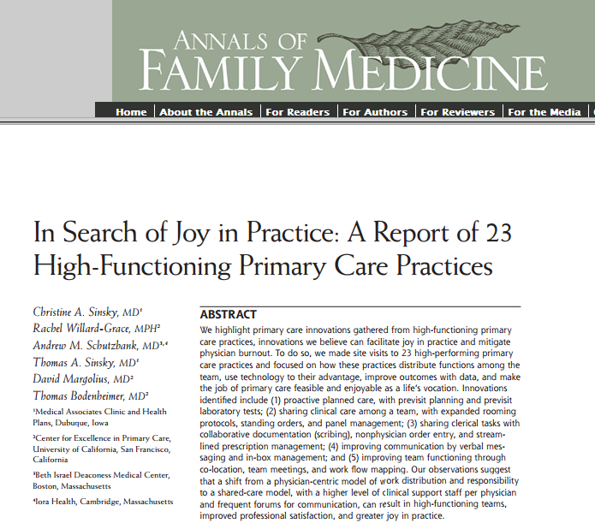
Ann Fam Med May/June 2013 vol. 11 no. 3 272-278

Slide 47
WRFP: A High Functioning Practice

Slide 48
Interconnected Health Community
WRFP and our patients
Geisel School of Medicine
Blueprint for Health
Health Care Reform
Community Health Team
ACO
eCW

Slide 49
Future Challenges Goals
More sophisticated data analytics
eCW Analytics
Combining data streams with others
Payers, HIE, Statewide all claims database
Social Networks
ACO
Patient Engagement/Patient Confidence

Slide 50
References
Statistical Process Control (Graphs):
Carey RG. Improving Healthcare With Control Charts: Basic and Advanced SPC Methods and Case Studies. Milwaukee, Wis:: ASQ Quality Press; 2003.
SPC XL Software used: Air Academy Associates, http://sigmazone.com/spcxl.htm
Health Confidence:
Ho, L., Haresch, J. W., Nunlist, M., Schwarz, A., Wasson, J. H., Improvement of Patients’ Health Confidence. Journal of Ambulatory Care Management, 36(3), 235–240.

Slide 51
Questions? Sean Uiterwyk, MD suiterwyk@wrfpvt.com whiteriverfamilypractice.com Twitter: @WRFPvt

